Slide 1

Predicting house prices
aMES HOUSING DATA
Submitted by: Team 3b

Slide 2

DATA SUMMARY
Training Data
Test Data
1460 data points
81 features
Includes Sales price column
1459 data points
80 features
No Sales price
Need to predict

Slide 3
EDA– TARGET VARIABLE
Sales price
Log Sales price
Right skewed
Right skewed

Slide 4
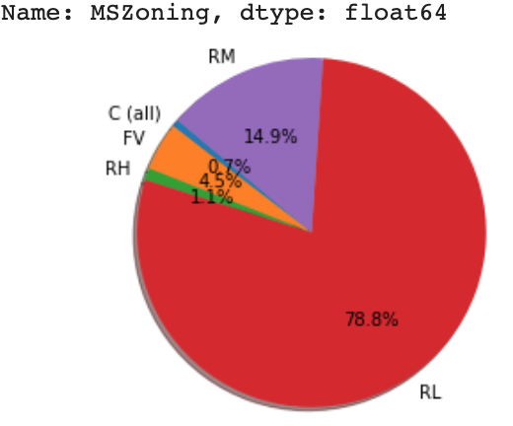
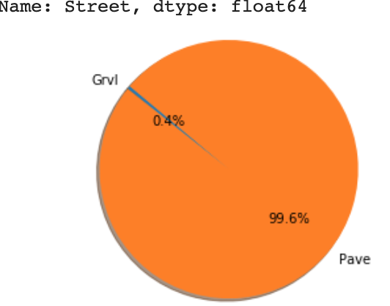
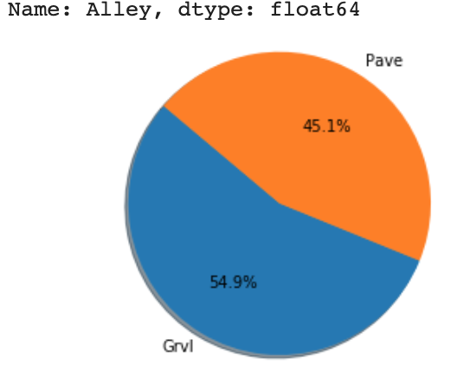
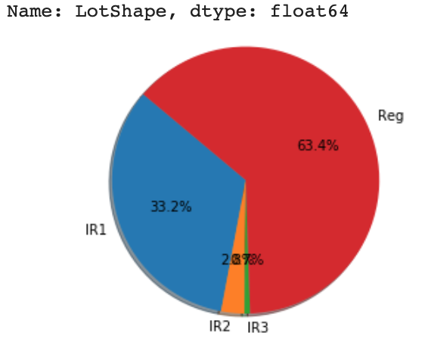
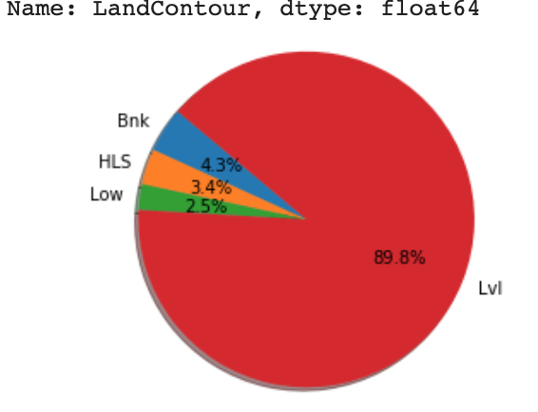
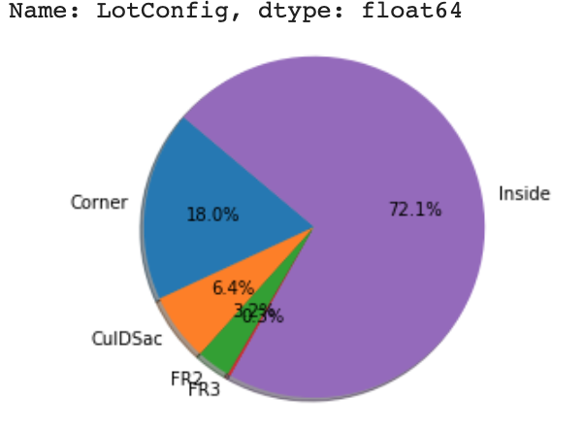
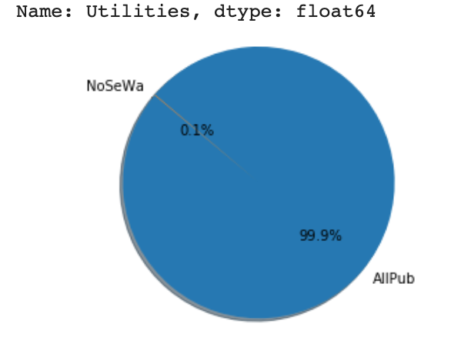
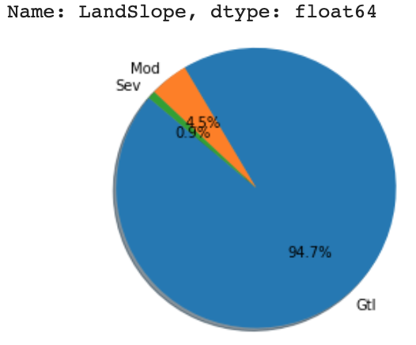
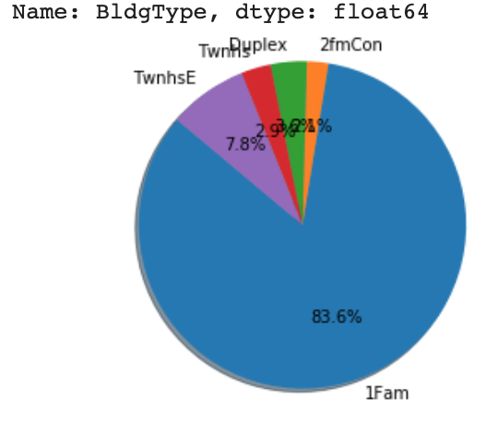
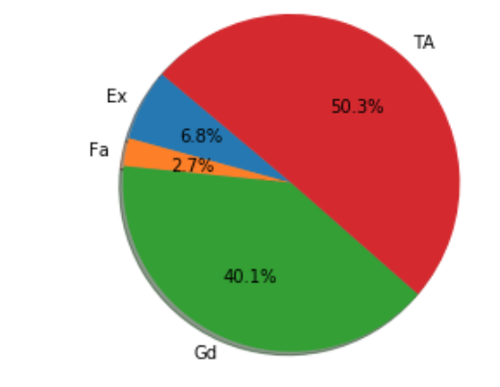
EDA - Categorical variables
MS ZONING
STREET
ALLEY
LOTSHAPE
LANDCONTOUR
LOTCONFIG
UTILITIES
LANDSLOPE
BLDGTYPE
KITCHEN QUAL

Slide 5
missing DATA
TRAIN DATA
6965
TEST DATA
7000

Slide 6
Missing train data missing test data
Feature | # of data points missing | % of data missing
PoolQC | 1453 | 99.52
MiscFeature | 1406 | 96.3
Alley | 1369 | 93.76
Fence | 1179 | 80.75
FireplaceQu | 690 | 47.26
LotFrontage | 259 | 17.73
GarageYrBlt | 81 | 5.54
GarageType | 81 | 5.54
GarageFinish | 81 | 5.54
GarageQual | 81 | 5.54
GarageCond | 81 | 5.54
BsmtFinType2 | 38 | 2.6
BsmtExposure | 38 | 2.6
BsmtFinType1 | 37 | 2.53
BsmtCond | 37 | 2.53
BsmtQual | 37 | 2.53
MasVnrArea | 8 | 0.54
MasVnrType | 8 | 0.54
Electrical | 1 | 0.06
Feature | # of data points missing | % of data missing
PoolQC | 1456 | 99.79
MiscFeature | 1408 | 96.5
Alley | 1352 | 92.66
Fence | 1169 | 80.12
FireplaceQu | 730 | 50.03
LotFrontage | 227 | 15.5
GarageYrBlt | 78 | 5.34
GarageCond | 78 | 5.34
GarageQual | 78 | 5.34
GarageFinish | 78 | 5.34
GarageType | 76 | 5.20
BsmtCond | 45 | 3.08
BsmtExposure | 44 | 3.01
BsmtQual | 44 | 3.01
BsmtFinType1 | 42 | 2.87
BsmtFinType2 | 42 | 2.87
MasVnrType | 16 | 1.09
MasVnrArea | 15 | 1.02
Others

Slide 7
Missing value treatment
Combined: (2918,74)
0 missing values
Removed 5 columns with more than 40% missing data from both Train & Test
Removed 1 row with missing data in electrical column from Train
Imputed numerical columns with mean on combined Train & Test
Imputed categorical columns with mode on combined Train & Test
Combined: (2918,74)
Train: (1459,75)
Test: (1459,74)
Train: (1460,75)
Test: (1459,74)
Train: (1460,80)
Test: (1459,79)

Slide 8
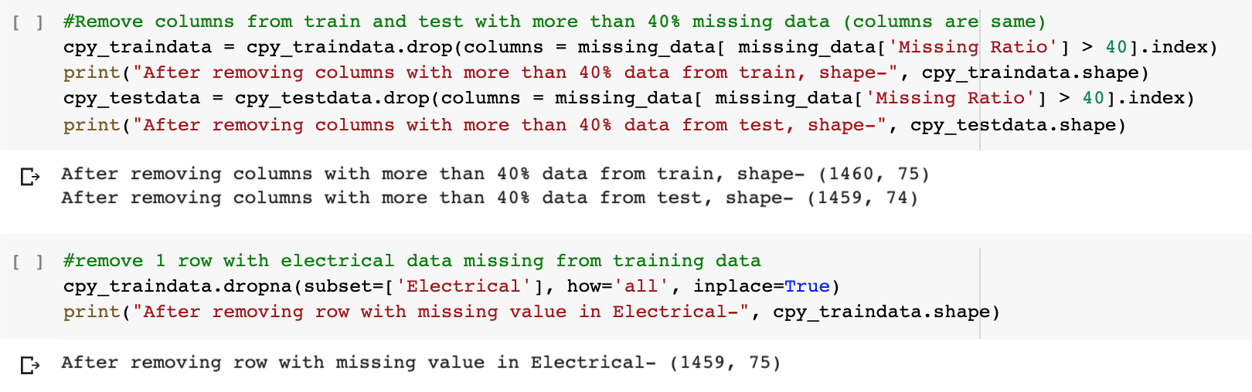
missing VALUE TREATMENT CODE
1
2

Slide 9
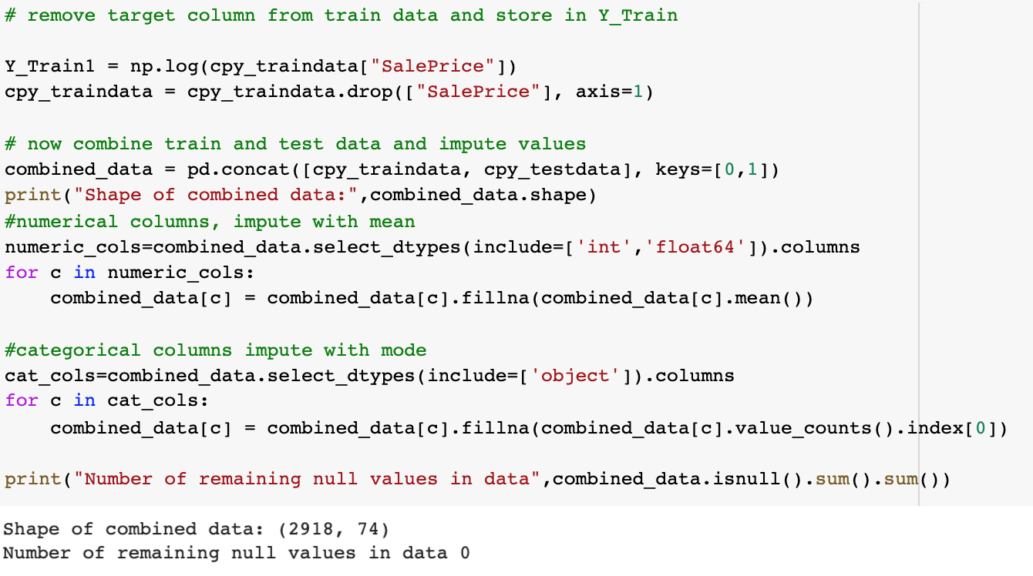
missing VALUE TREATMENT CODE
3
4

Slide 10
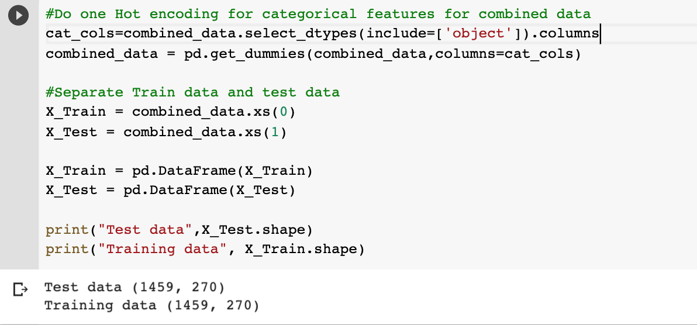
One hot encoding

Slide 11
REMOVED 17 highly CORRELATED FEATURES

Slide 12
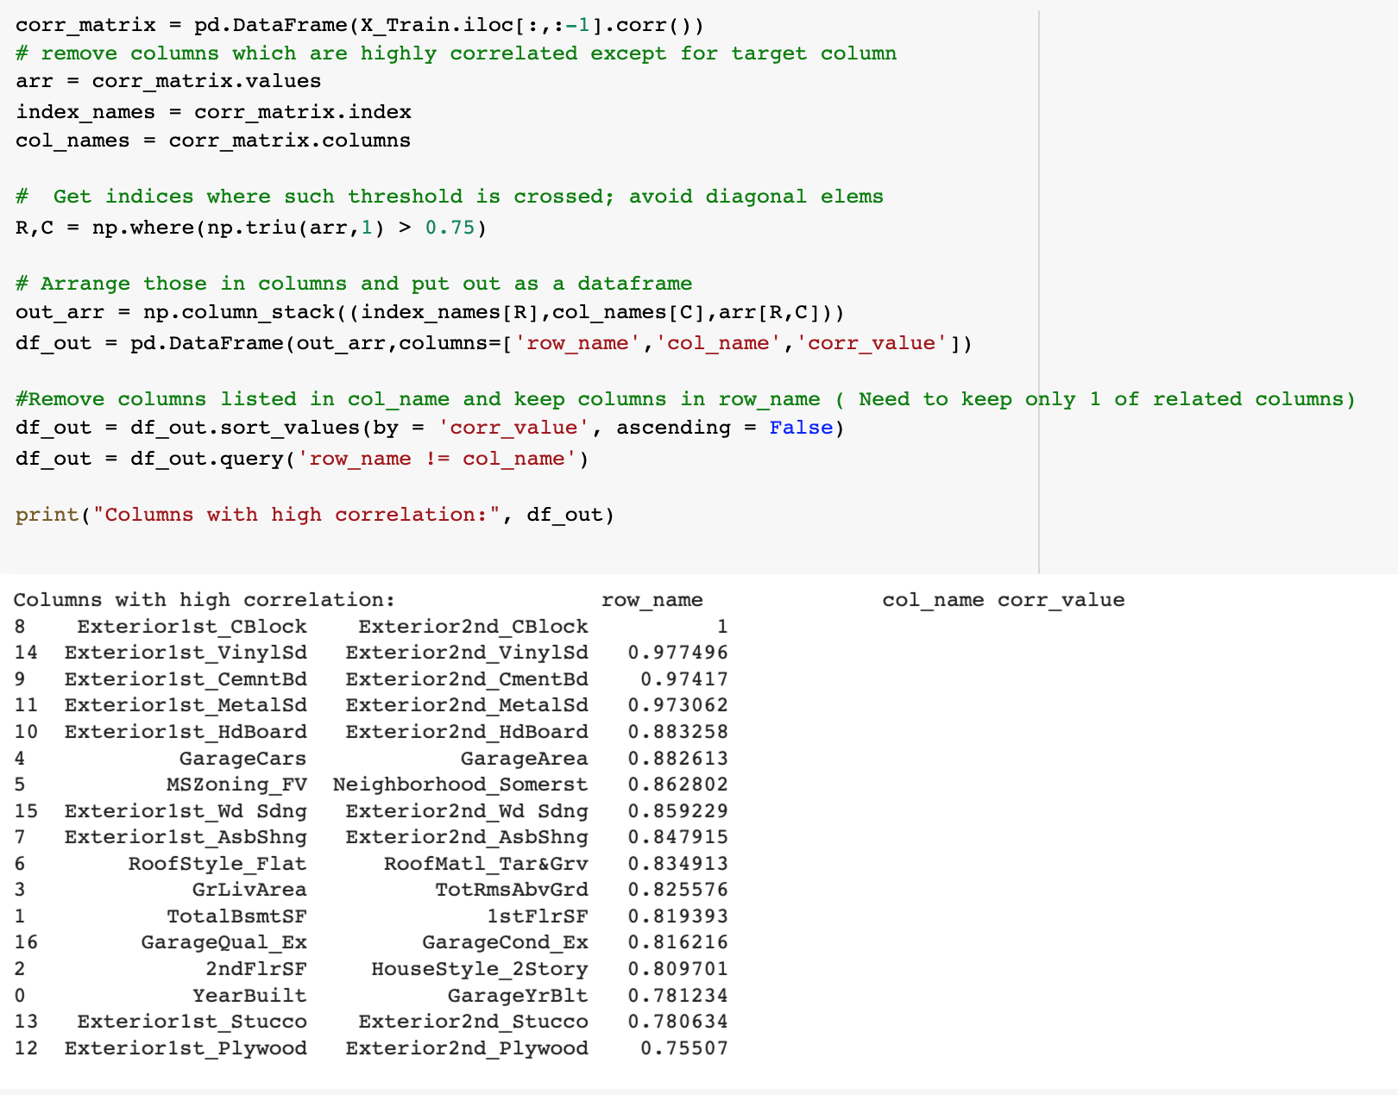
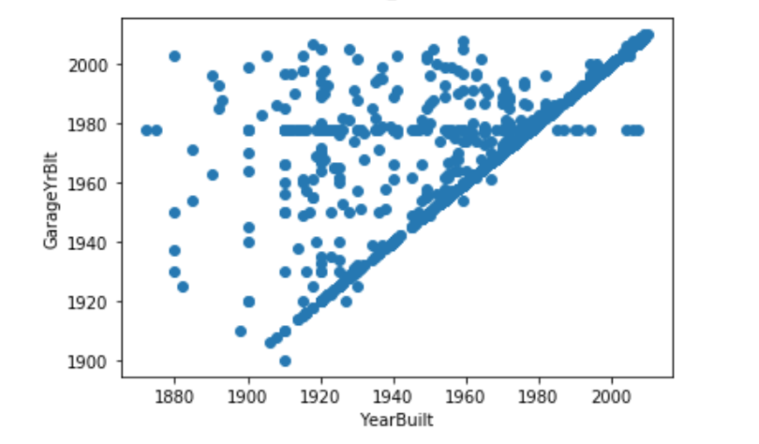
Finding correlated columns

Slide 13
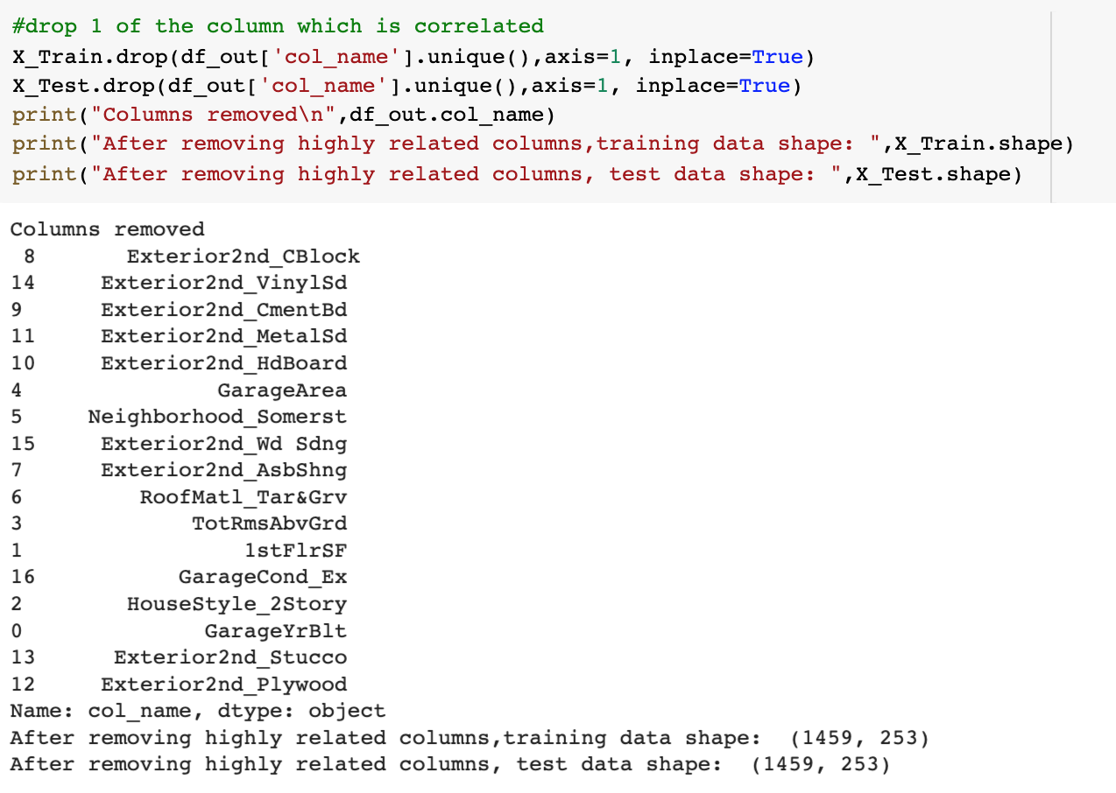
Removing 1 correlated columns

Slide 14
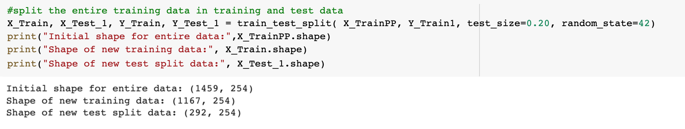
Train test split – 80:20

Slide 15
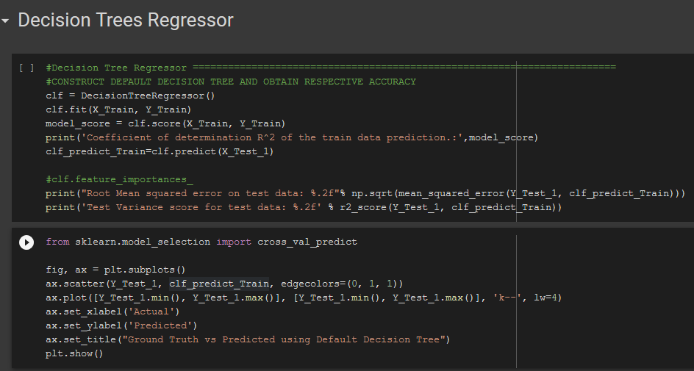
Coefficient of determination R^2 of the train data prediction.: 0.9999999940379681
RMSE on test 0.21

Slide 16
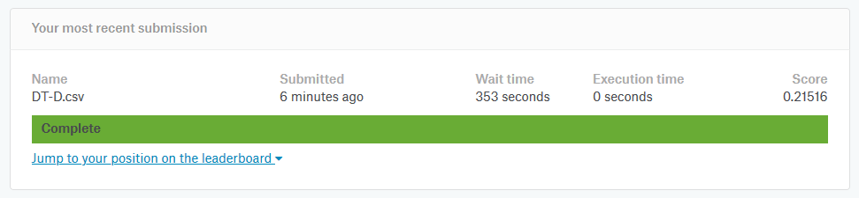
KAGGLE SCORE

Slide 17
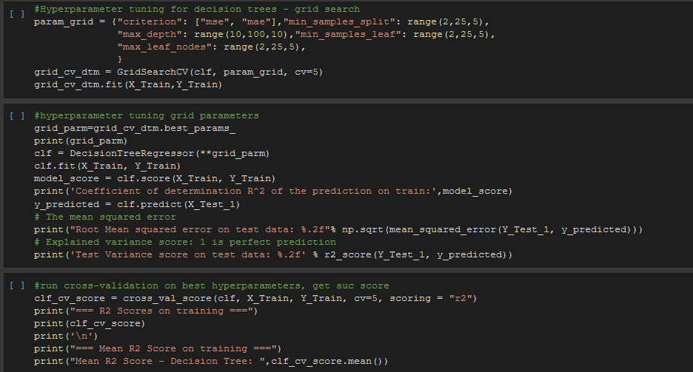
Coefficient of determination R^2 of the prediction on train: 0.7983408025313363
RMSE on test 0.20

Slide 18
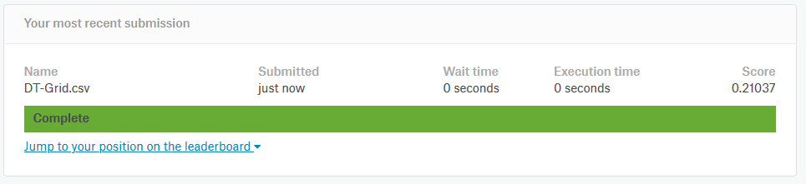
KAGGLE SCORE

Slide 19
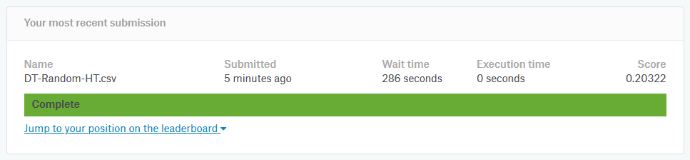
KAGGLE SCORE

Slide 20
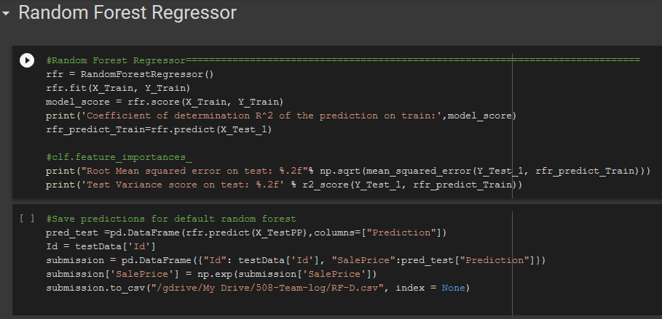
Coefficient of determination R^2 of the prediction on train: 0.9724403118852285
RMSE on test 0.15

Slide 21
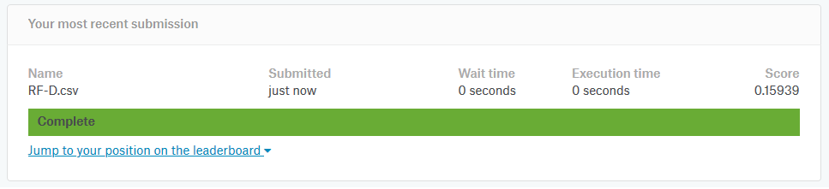
KAGGLE SCORE

Slide 22
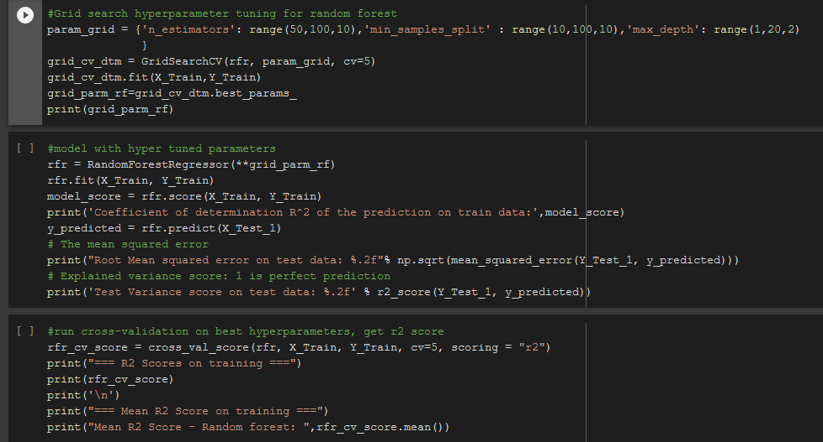
coefficient of determination R^2 of the prediction.: 0.9647470237676757
RMSE on test 0.14

Slide 23
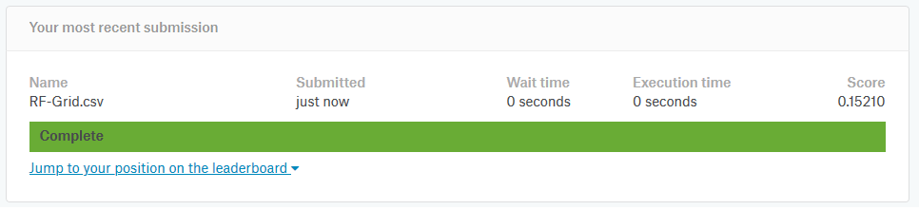
KAGGLE SCORE

Slide 24
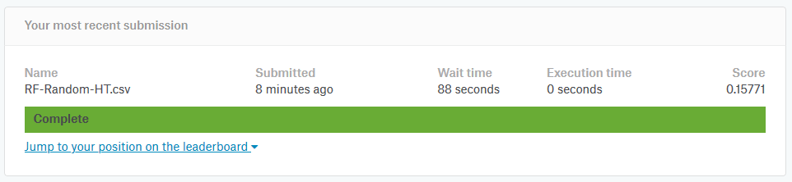
KAGGLE SCORE

Slide 25
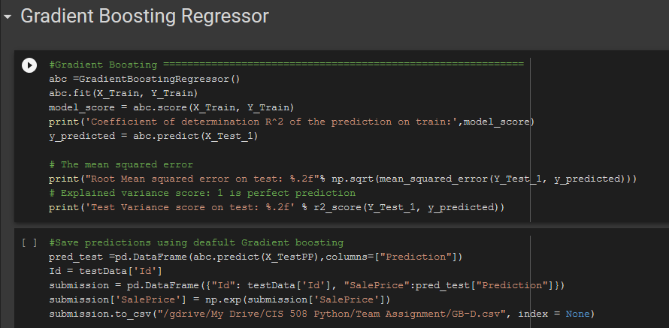
Coefficient of determination R^2 of the prediction on train: 0.9615589091982971
RMSE on test 0.13

Slide 26
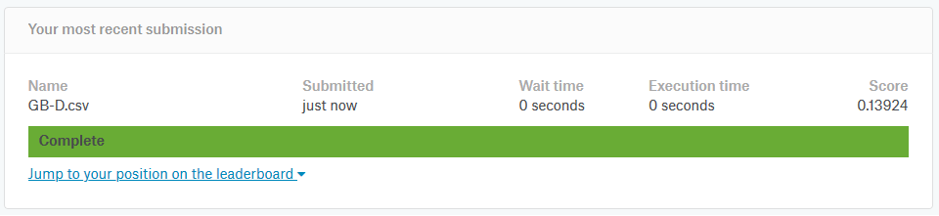
KAGGLE SCORE

Slide 27
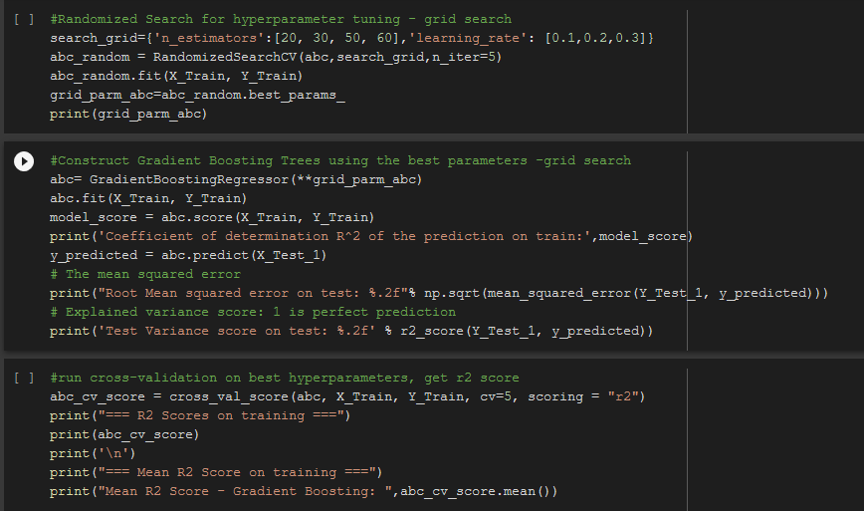
Coefficient of determination R^2 of the prediction on train: 0.9641628828423412
RMSE on test 0.12

Slide 28
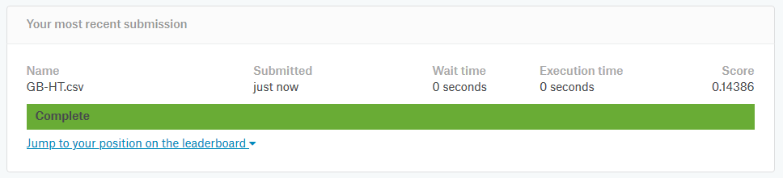
KAGGLE SCORE

Slide 29
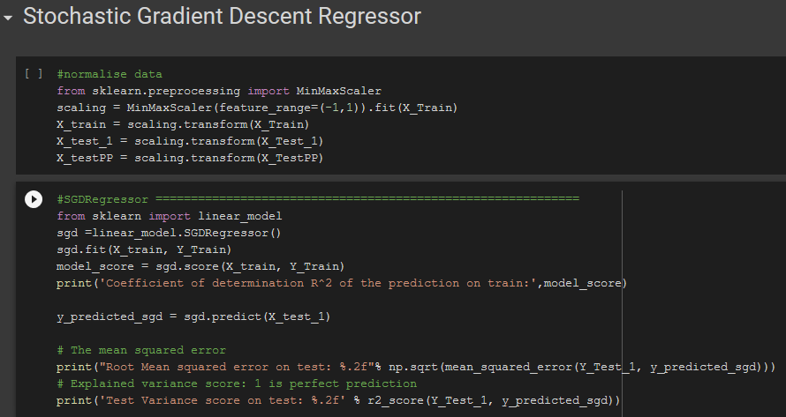
1
Coefficient of determination R^2 of the prediction on train: 0.8640988434079933
RMSE on test 0.15

Slide 30
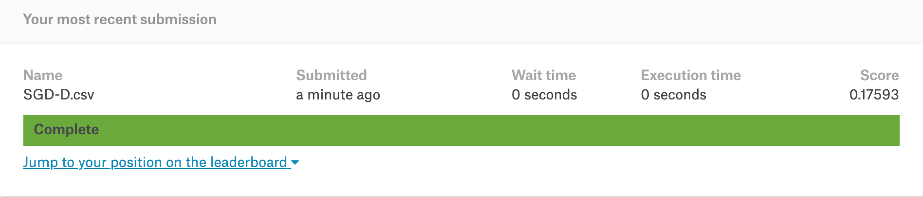
KAGGLE SCORE

Slide 31
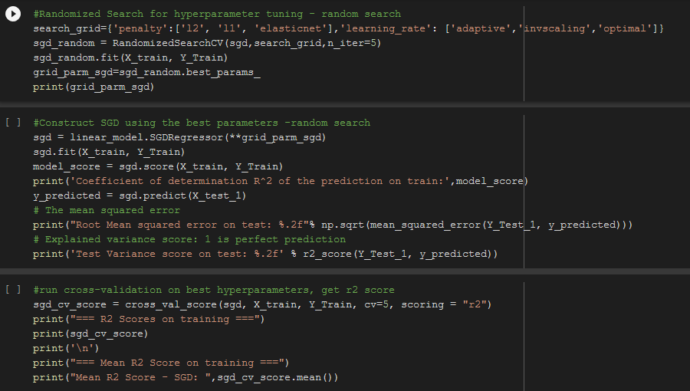
Coefficient of determination R^2 of the prediction on train: 0.8694706408160053
RMSE on test 0.15

Slide 32
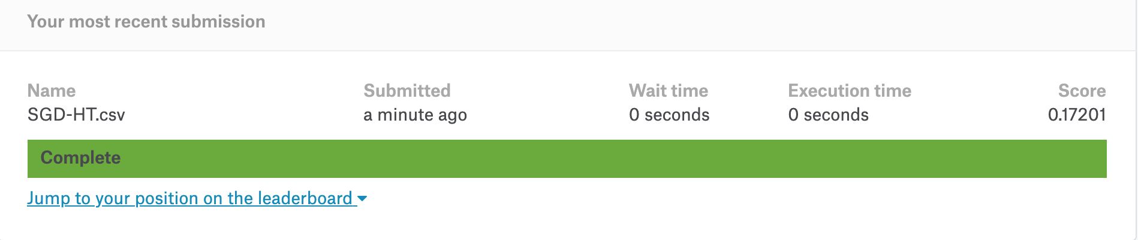
KAGGLE SCORE

Slide 33
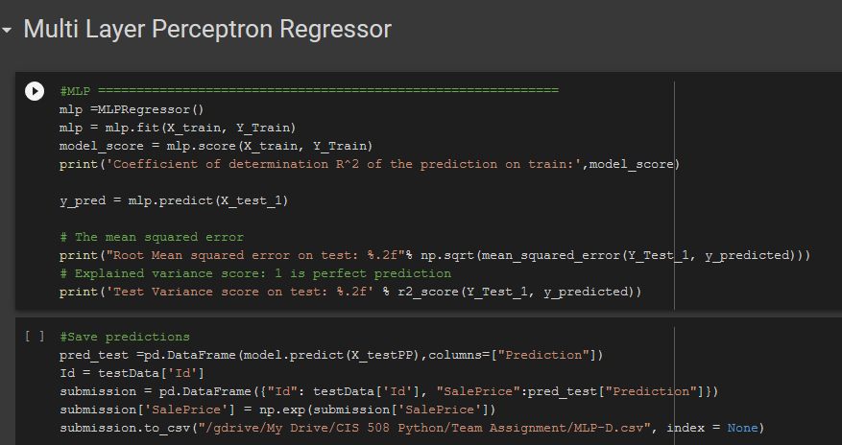
Coefficient of determination R^2 of the prediction on train: 0.8490119448795729
RMSE on test 0.14

Slide 34
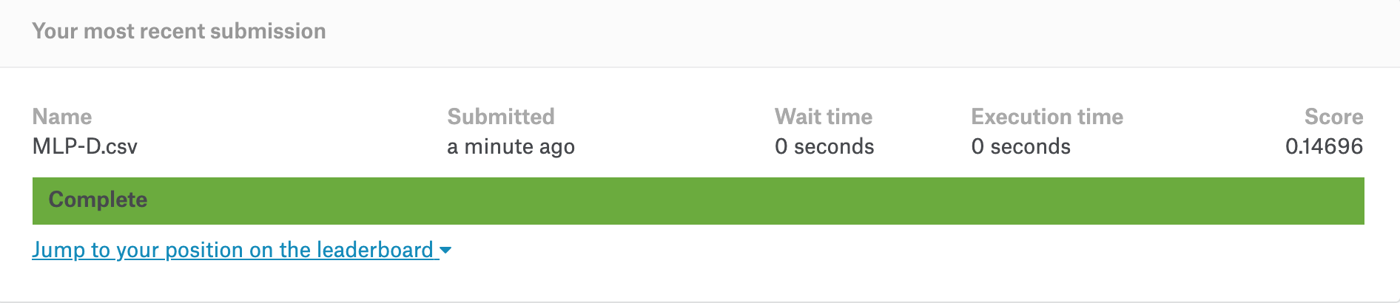
KAGGLE SCORE

Slide 35
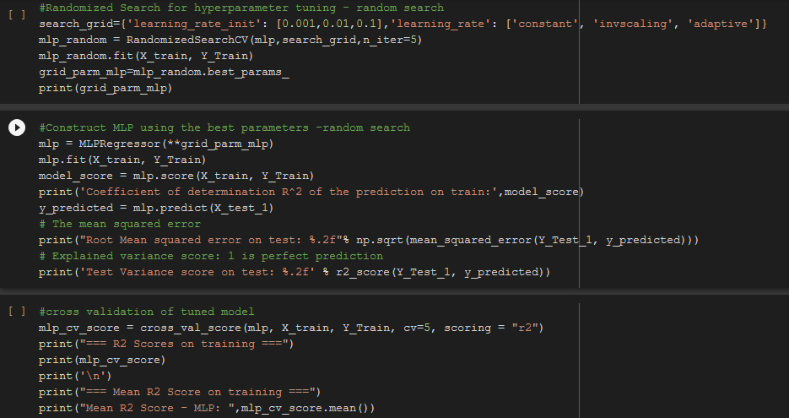
Coefficient of determination R^2 of the prediction on train: 0.8936736694140653
RMSE on test 0.14

Slide 36
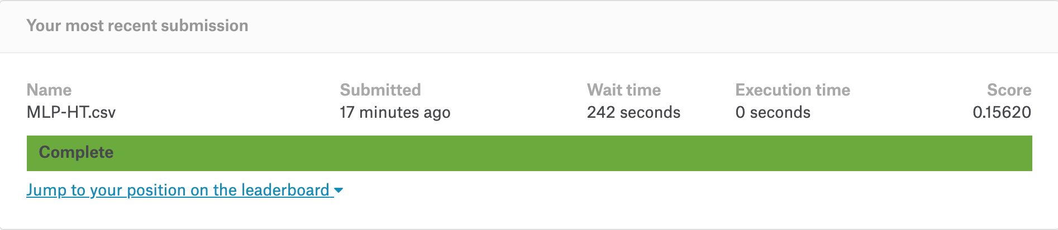
KAGGLE SCORE

Slide 37
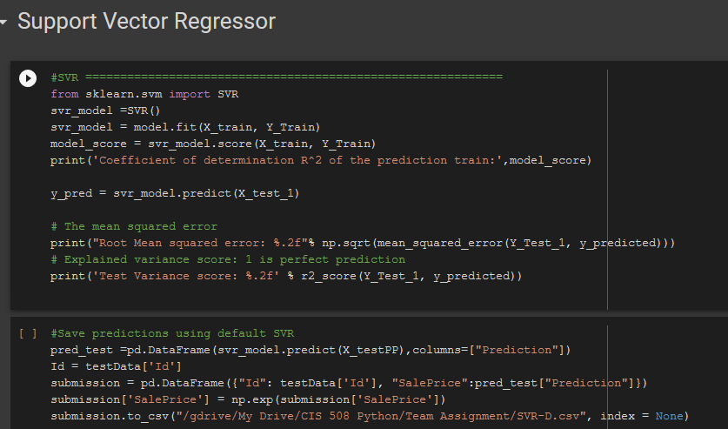
Coefficient of determination R^2 of the prediction train: 0.9261251790350611
RMSE on test 0.14

Slide 38
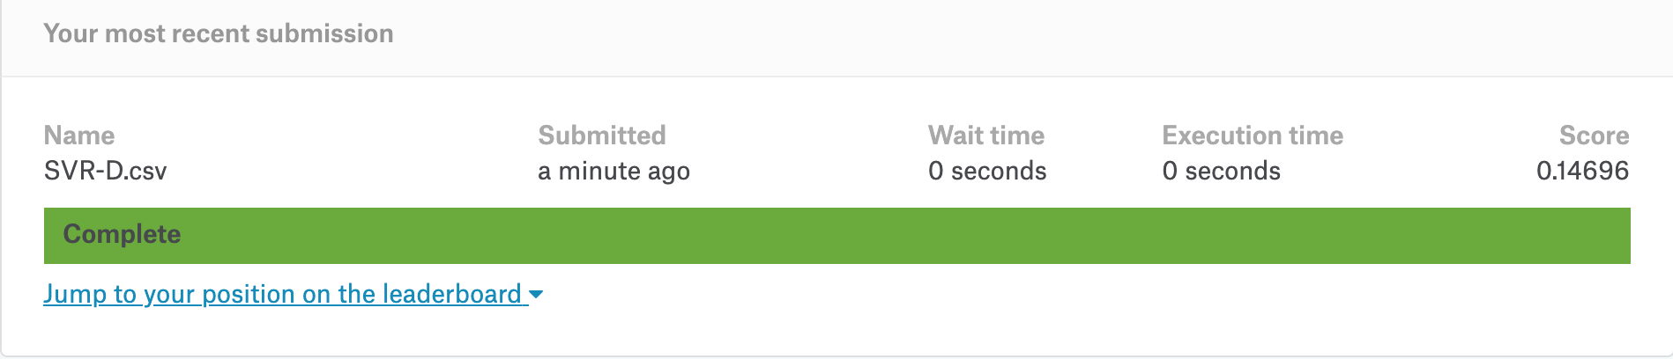
KAGGLE SCORE

Slide 39
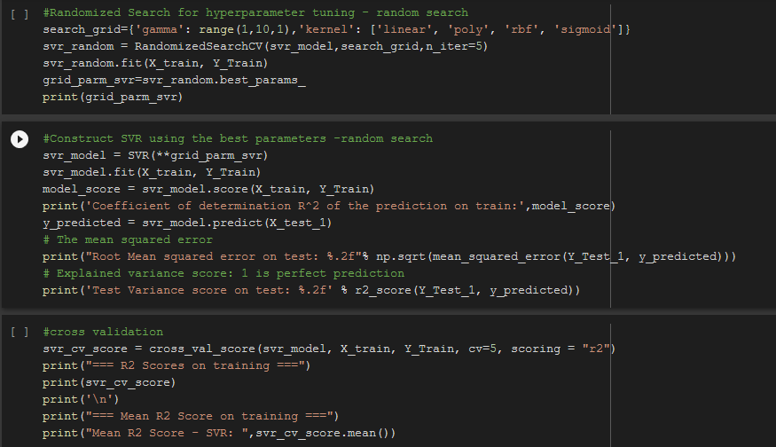
Coefficient of determination R^2 of the prediction on train: 0.9636155668310397
RMSE on test 0.14

Slide 40
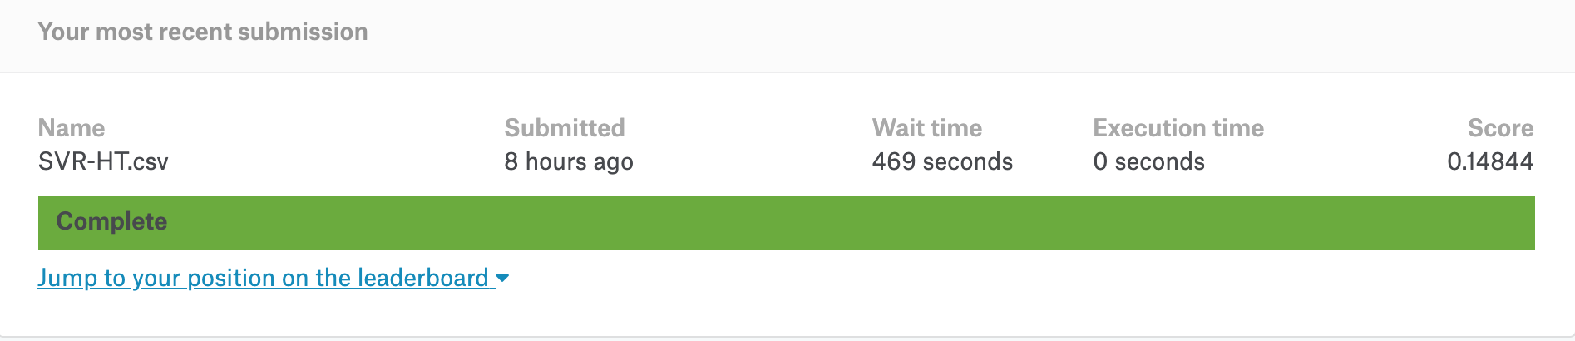
KAGGLE SCORE

Slide 41
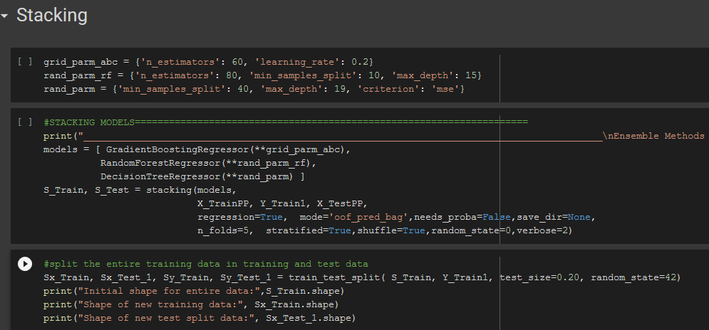

Slide 42
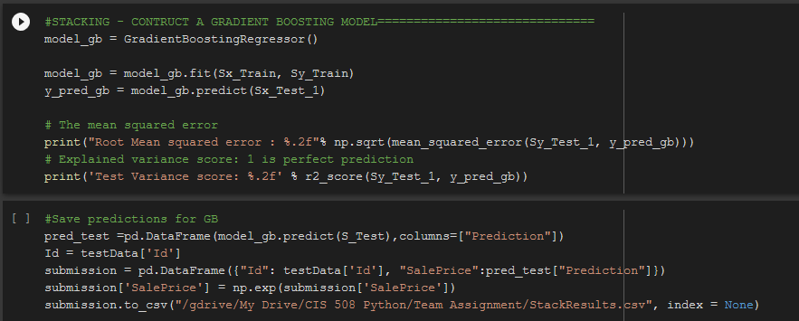
RMSE on test 0.14

Slide 43
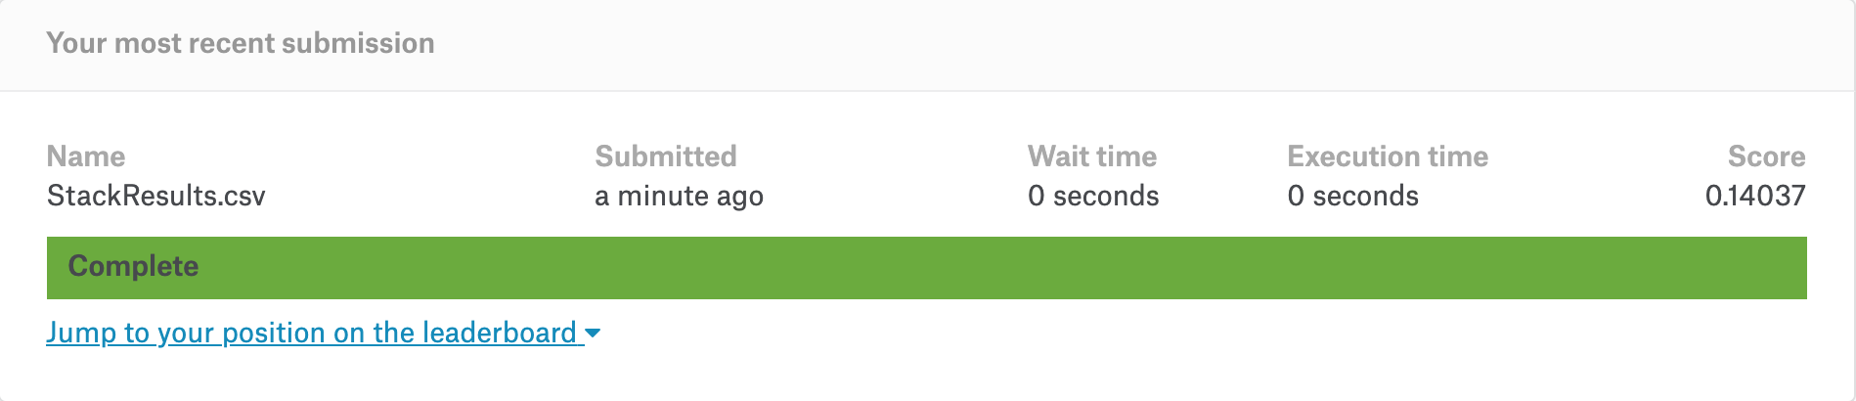
KAGGLE SCORE WITH GRADIENT BOOSTING

Slide 44
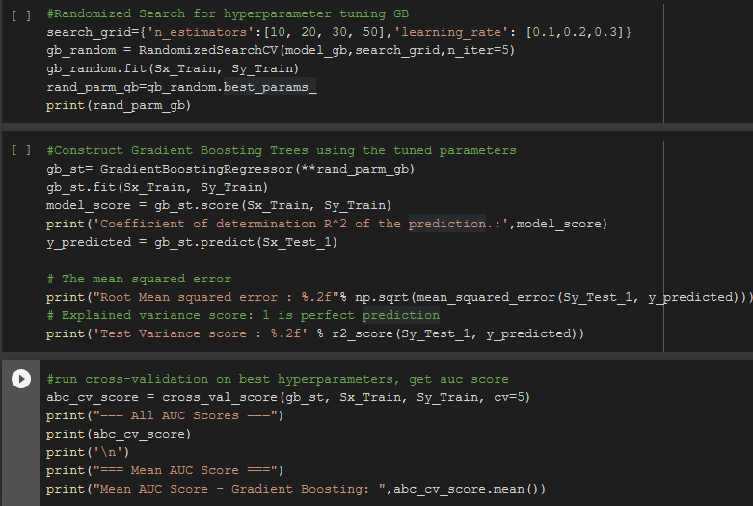
coefficient of determination R^2 of the prediction.: 0.9279704776200255
RMSE on test 0.14

Slide 45
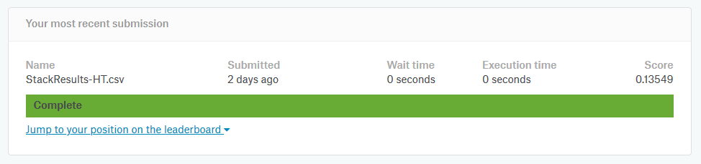
KAGGLE SCORE WITH GRADIENT BOOSTING HT

Slide 46
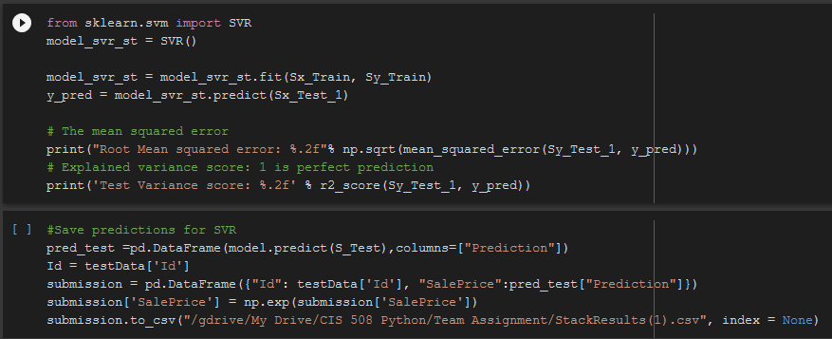
RMSE on test 0.13

Slide 47
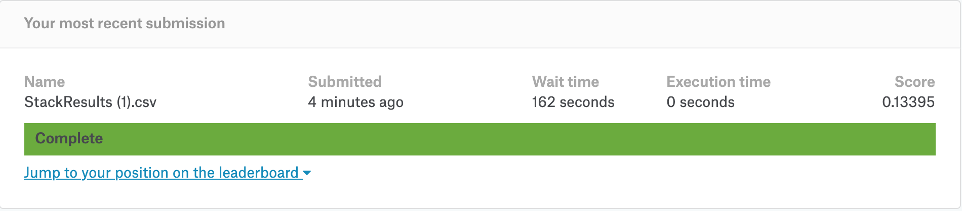
KAGGLE SCORE WITH SVR META MODEL

Slide 48

Coefficient of determination R^2 of the prediction.: 0.8873469741428477
RMSE on test 0.13

Slide 49

KAGGLE SCORE WITH SVR META MODEL HT

Slide 50
Kaggle Score Comparison
 | Model | Kaggle Score
 | DT-D | 0.21516
 | DT-GRID | 0.21037
 | DT-RANDOM-HT | 0.20322
 | RF-D | 0.15939
 | RF-GRID | 0.15210
 | RF-RANDOM-HT | 0.15771
 | GB-D | 0.13924
 | GB-HT | 0.14386
 | MLP-D | 0.14696
 | MLP-HT | 0.15620
 | SGD-D | 0.17593
 | SGD-HT | 0.17201
 | SVR-D | 0.14696
 | SVR-HT | 0.14844
 | StackResults GB | 0.14037
 | StackResults GB HT | 0.13549
 | StackResults SVR | 0.13395
 | StackResults-SVR HT | 0.13231

Slide 51
Key Take-Aways
Hyperparameter tuning helped in improving the model.
Stacking helped in significant improvement of the model.
Surprisingly, Gradient Boosting with default parameters is performing at par with stacked models.
Data normalization improved MLP, SGD, SVR models way high.

Slide 52

THANK YOU

